Slide 1
A Look into The Future of Edge Data Center

Slide 2
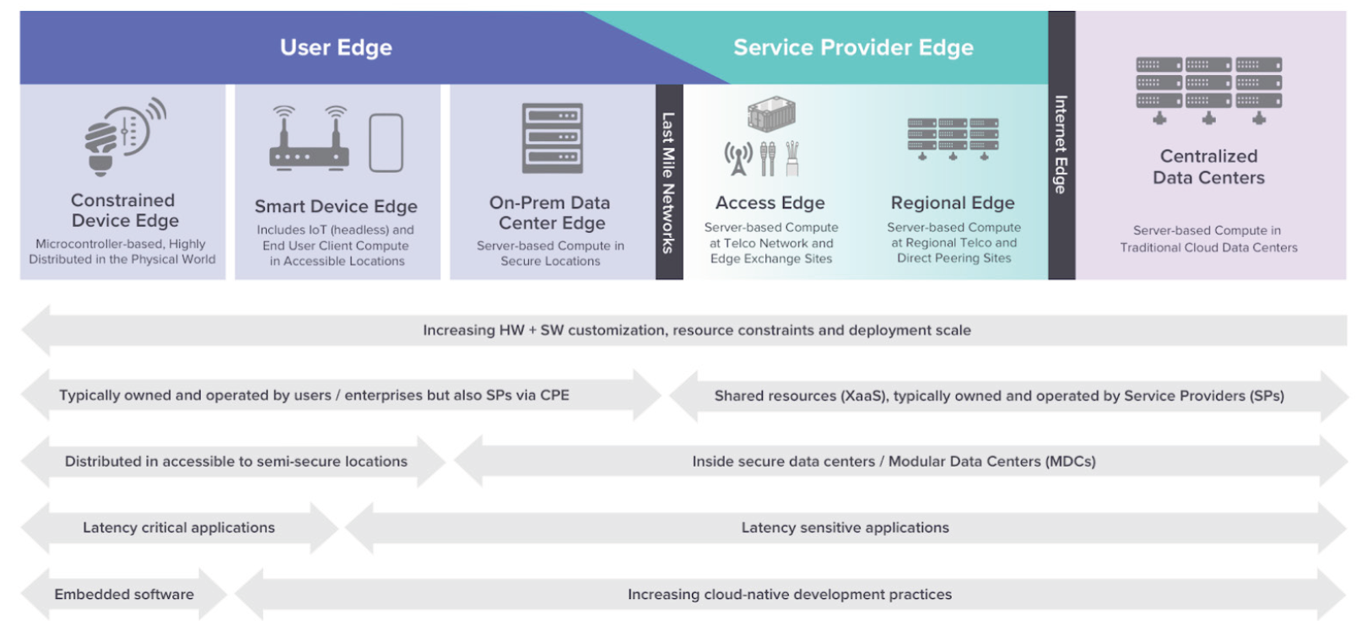
Edge Taxonomy
Notes:
对齐定义和讨论范围的边界

Slide 3
Edge Explosion
Notes:
IDC® predicts 175ZB data by 2025 [3]. Among these data, 90ZB are predicted to be produced by IoT devices, and an estimated 30% of the 175ZB data will be consumed real-time, which is mostly happening at the edge.

Slide 4
Edge Growth by Region

Slide 5
Edge Growth by Industry

Slide 6
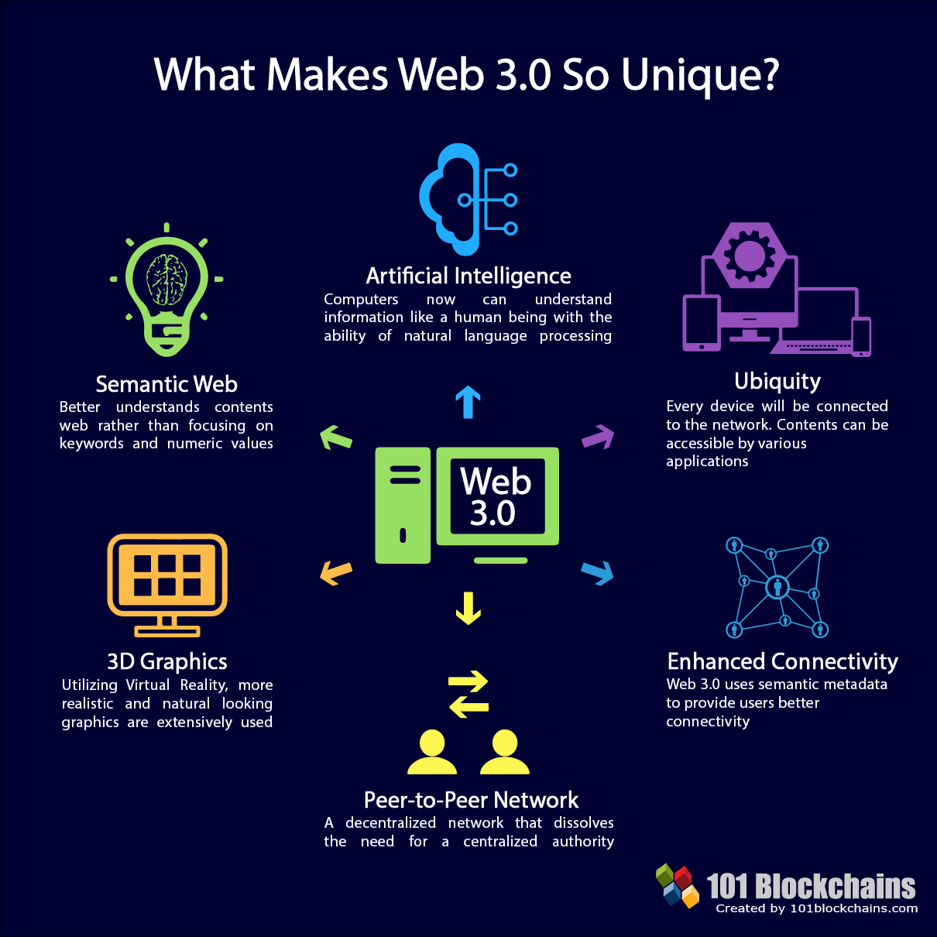
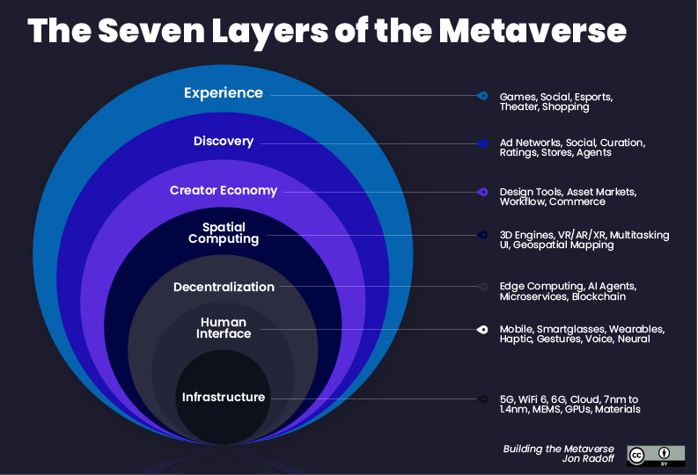
Edge Growth – Emerging Applications

Slide 7
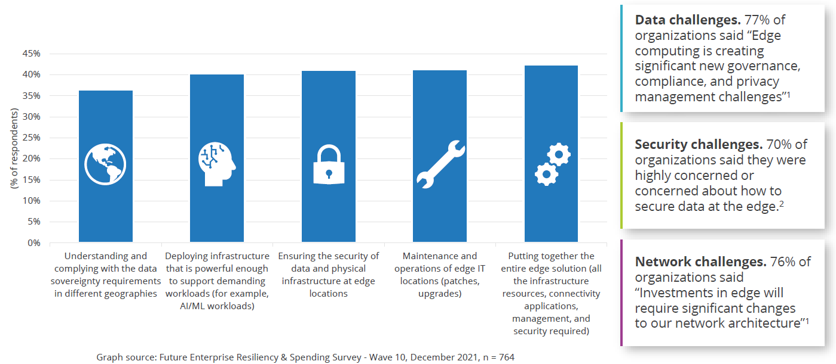
Edge Challenges
Notes:
Edge challenge is growing in two dimensions:
Data size, this is common sense now, everyone is trying to handle the situation.
Complexity of app and data matrix

Slide 8
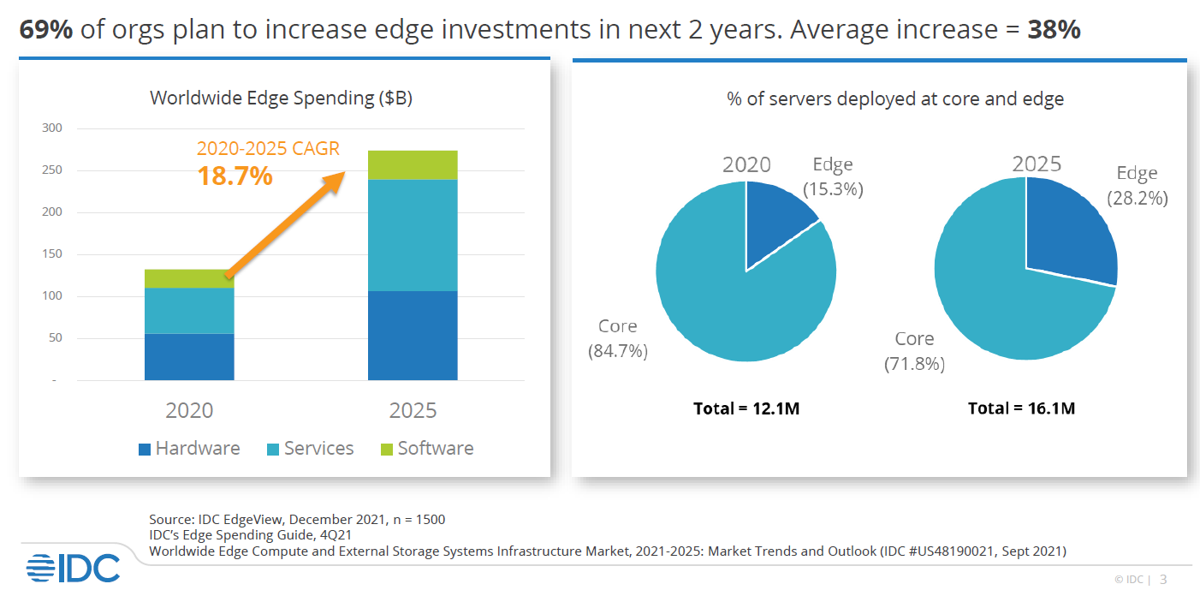
Edge Market Prediction

Slide 9
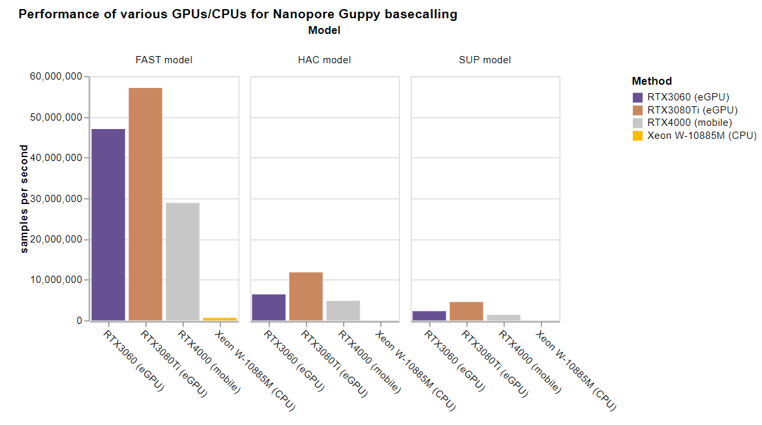
Edge Solution Consideration #1 – Hardware Boost Efficiency

Slide 10
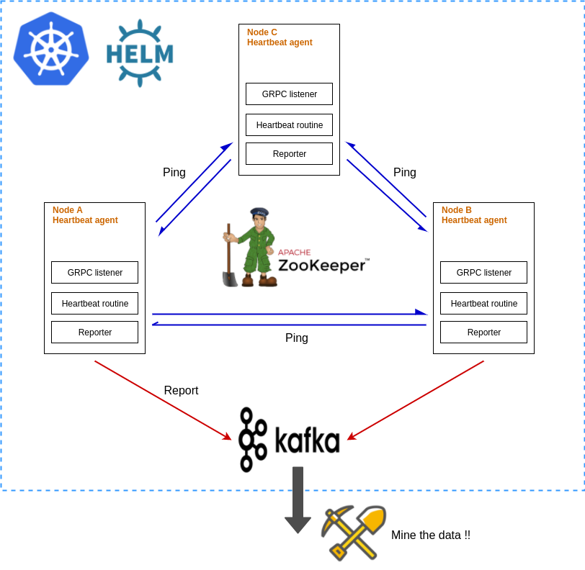
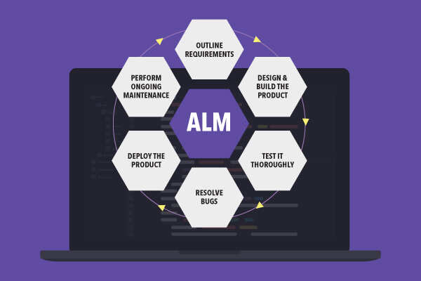
Edge Solution Consideration #2 – App Integration Reduce OpEx
One click deployment for measuring networking availability of your K8s cluster
Notes:
Application lifecycle management takes the majority of HR resources in datacenters
Left side example shows an one-click deploy example from open source community:
https://medium.com/@johankok/one-click-deployment-for-measuring-networking-availability-of-your-kubernetes-cluster-cab1243fb56f

Slide 11


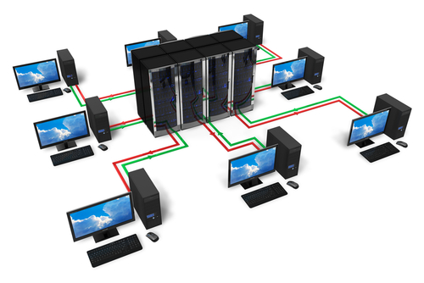




Edge Solution Consideration #3 – PayU Simplifies CapEx
Key Technology
User
Consumption analytics
In each components:
Storage
Servers
Container orchestration
In solution level:
Composable infrastructure
Budgeting and
Metering service
Data center services
Billing
System Administration service
Public cloud services
Managed service team

Slide 12
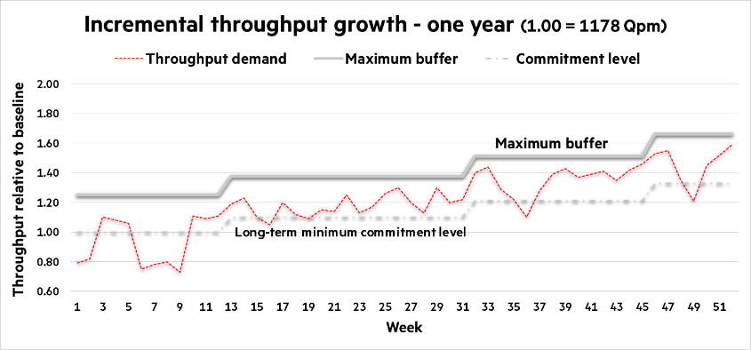
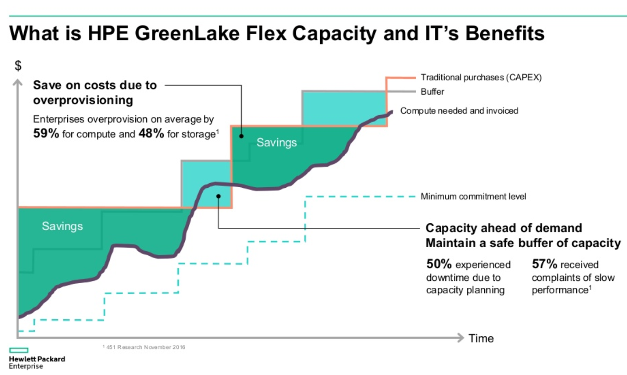
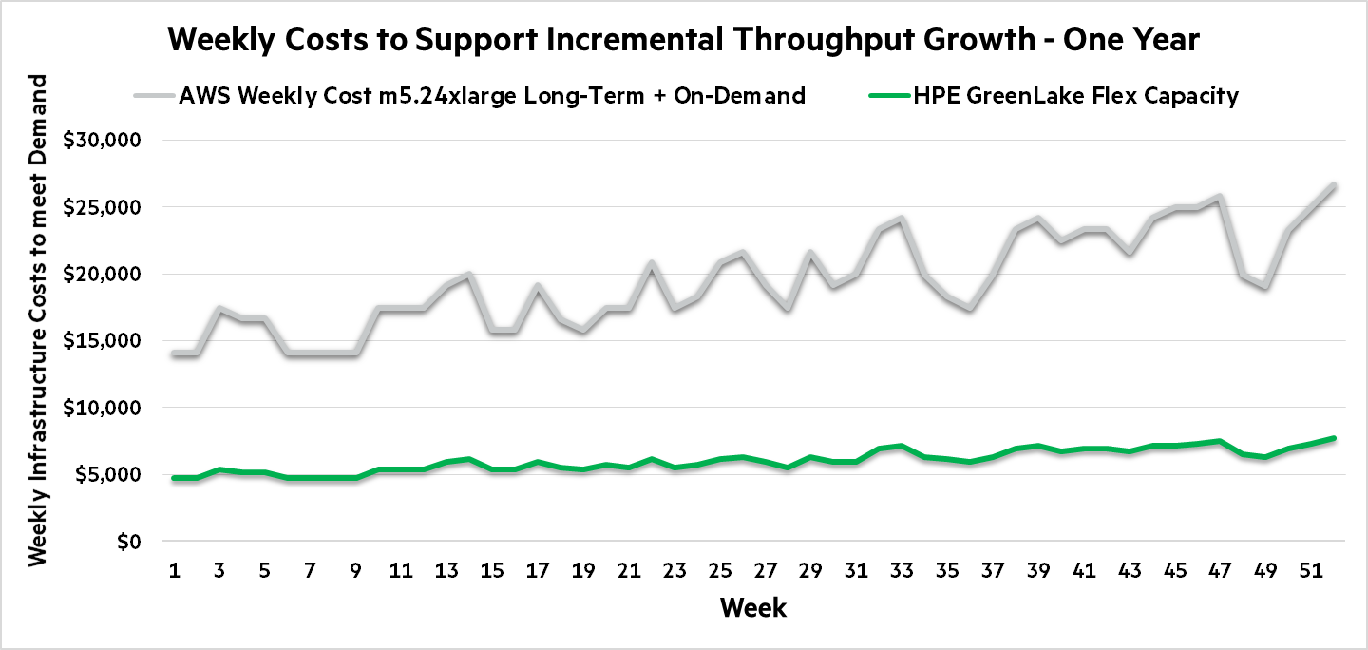
Edge Solution Consideration #3 – HPE® Reference

